Slide 2
Welcome & Opening Prayer
Welcome – Alison & Scott Lyon, Campaign Directors
Opening Prayer – Kim McGuigan, Prayer Coordinator

Slide 3
Campaign Verse – Devotion Pastor Yonker
“Have I not commanded you? Be strong and courageous. Do not be terrified; do not be discouraged, for the Lord your God will be with you wherever you go.”
Joshua 1:9

Slide 4
Our Goals – Chris Wendt
School Feasibility Study - $200,000
Retire D’Angelo Property Debt - $984,000
Expand our Marketing and Outreach Efforts - $150,000
Enhance our church entrance - $150,000

Slide 5
School Feasibility Study
We Graduate 20 to 30 Disciples Annually
New school ?
Curb Cuts, Soil Study, Wetlands, Etc.
School Addition?
Asbestos, Elevator, Sprinklers, Boiler, Etc.
Demographics?

Slide 6
Retire Property Debt
Original Principal - $1,290,000
Current Principal- $984,000
Interest Rate
Original Rate 3.875%
Present Rate 3.4%
Will adjust in October 2026
Eagle Zone

Slide 7
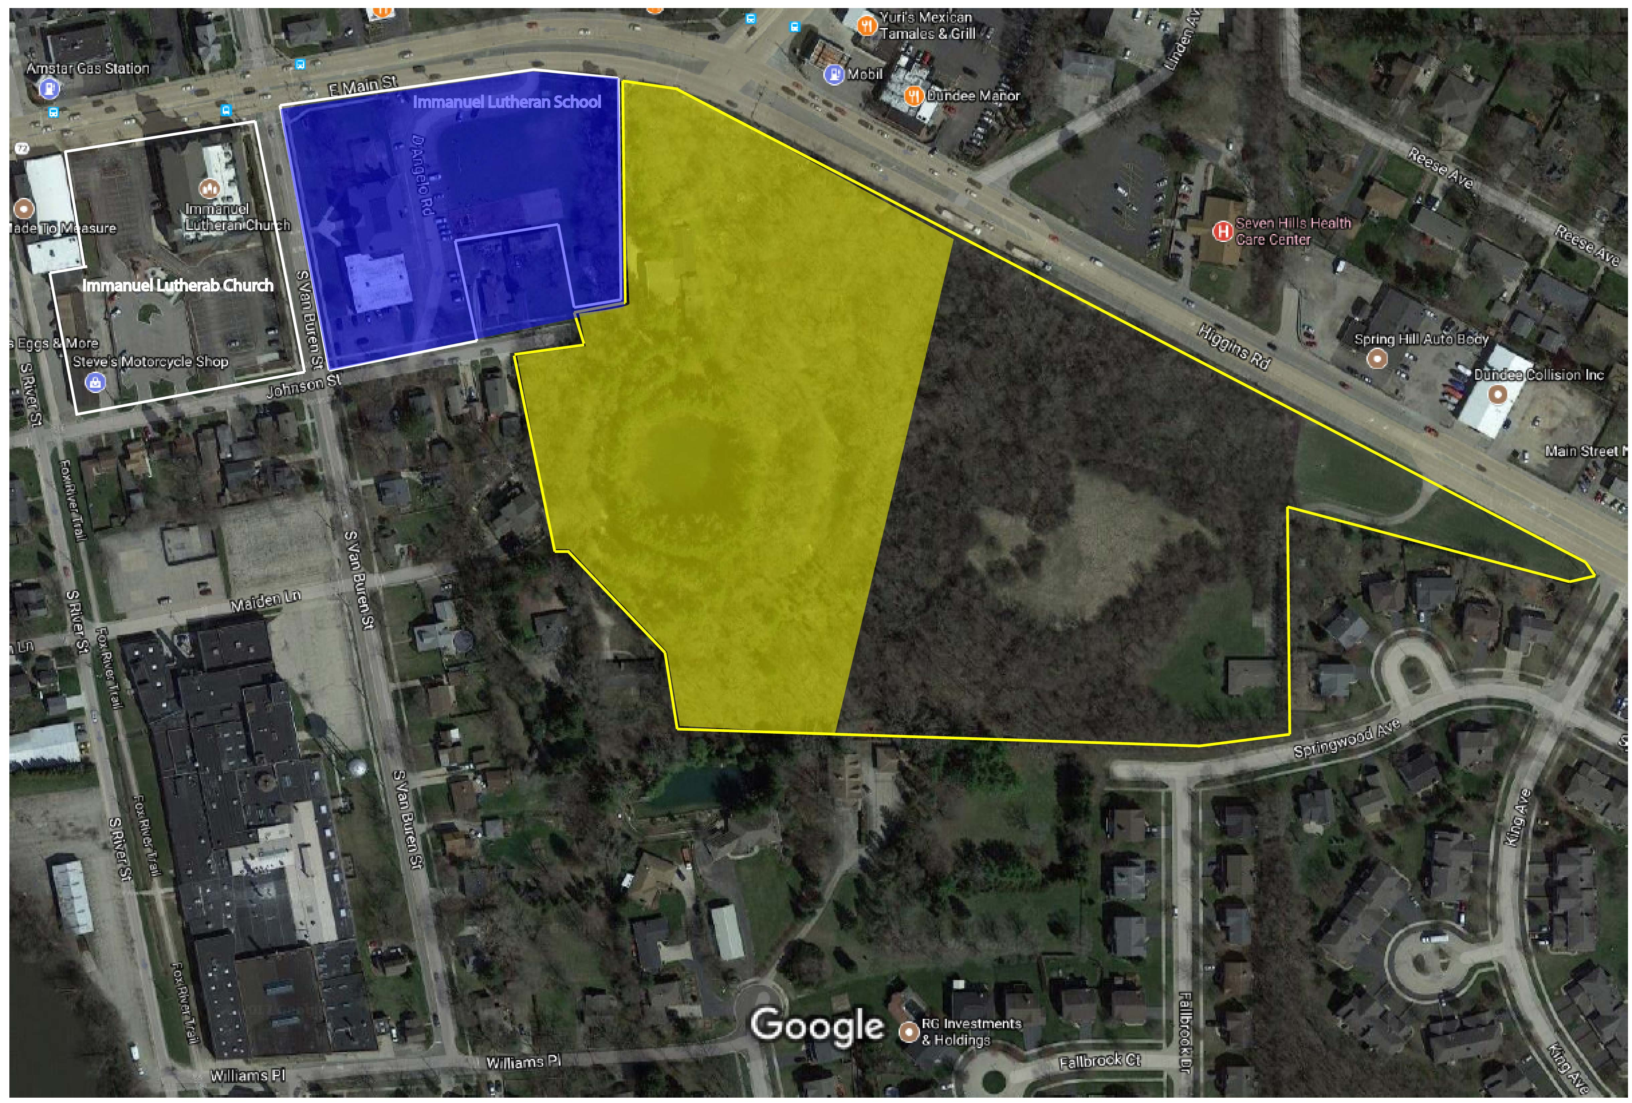

Slide 8
Expand Outreach & Marketing
Improve our visibility throughout the community
Put “Evangelical” in Immanuel Evangelical Church & School
Push the Immanuel “Brand”
Website
Social Media
Community Involvement
Professional Help

Slide 9
Enhance the Church Entrance
Add Welcome Center
Enhance Church Security
Reconfigure Atrium

Slide 10
Questions?

Slide 11
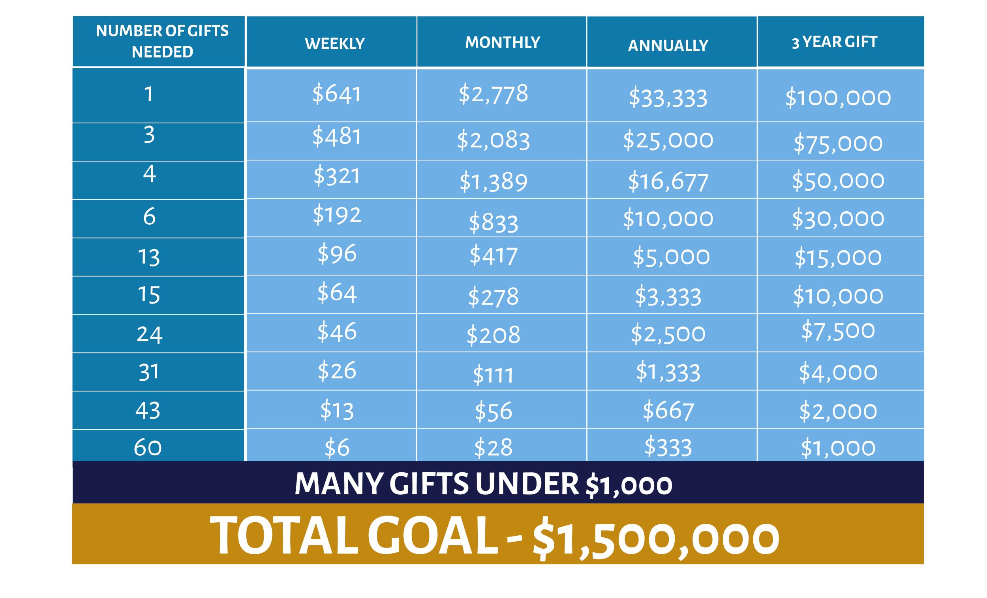
Gift Pyramid Review Alison & Scott Lyon
Not
Equal
Giving
But
Equal
Sacrifice

Slide 12
Questions?

Slide 13
Important Dates Pastor Glombicki
Informational Forums – 9/16, 9/17, 9/19
Cottage Meetings – Month of October
Commitment Celebration – November 5th
First Gifts Sunday – November 19th

Slide 14
Questions?

Slide 15
Call To Action – Closing Prayer Pastor Yonker

Slide 16
Thank You for Attending!

